Slide 1

Measurement Topic 1:
The Development of Modern Political Thought
LT1/2: Explain The Connection Between The Important ideas of the enlightenment philosophers To The American Revolution (war), the Declaration of Independence and the bill of rights.

Slide 2
Key ideas from important documents
Magna Carta
English Bill of rights
Limit the power of the gov (KING)
Created 25 guys to watch king (Parliament)
Peoples property is protected from being taken over
People can not go to jail without being charged with a crime
Took almost all the King’s power away
More rights protected
  Freedom of speech
  No army in peace time
  Right to free elections
  No excessive fines
  No cruel and unusual punishment
  Permission needed to raise taxes

Slide 3
Enlightenment ideas
Montesquieu
Locke
  Everyone has rights
    Natural Rights –Life, liberty, and own property
  Government gets its power from the people
  If a government doesn’t protect the peoples rights it can be overthrown
Rousseau
  People are good, so they should create their own laws
  People should elect representatives to run the gov. for them
Separation of power
  When one person or group has all the power, then it becomes corrupt = violates people’s rights
  Separate a governments power up to keep it from being corrupt

Slide 4
Videos
Enlightenment
13 colonies (brain pop)
After next slide American revolutionary war causes (brain pop)
Notes:
LF- Notes for videos

Slide 5
Ideas Spread
Background on 13 colonies
The Enlightenment ideas spread all over the world!
  The new ideas make it to the 13 colonies (America)
13 colonies (America) were controlled/run/governed by England (1600-1770s)
13 colonies were not happy
Complaints 13 colonies had against England
  Taxes too high and too many new taxes
  Laws unfair
  They have no say in the government/laws created
  England will not listen to them and make changes
  Soldiers lived in their homes
  They didn’t have freedom of speech
  Soldiers took their property away
  People arrested without being charged
Notes:
LF notes: Have the learners discuss which rights from the Magana Carta, English bill of rights, natural rights were violated and have them highlight those violations

Slide 6
Ideas inspired a Revolution
13 colonies revolt
The colonists (people living in the 13 colonies) took the ideas from John Locke
  If a government is violating your rights then it can be overthrown
    They said the rights found in Magna Carta and the English Bill of rights are being violated
    They said our Natural Rights to life, liberty and property are being violated
They demand a divorce!!!
Leaders of the 13 colonies met
  Wrote the Declaration of Independence
    This documents outlined their rights
    It listed all the violations by the king of England
    At the end they declared their independence from England!!!!!!!!!
Notes:
http://www.history.com/news/9-things-you-may-not-know-about-the-declaration-of-independence

Slide 7
Assignment
Go back and highlight your notes for things you think are important
Create the flow map
Write a summary explaining all the actions/ideas that influenced the American revolution
Actions/Ideas
American Revolution
Use the following language: influenced, motivated, inspired, shaped, guided, led to, caused, resulted in, developed, changed, transformed
Notes:
There are several reason why ____________. One reason that _______ was________. Another reason for _________ was _________. Another (idea/action) that influenced/motivated/inspired the ___________ to __________ was____________.

Slide 8
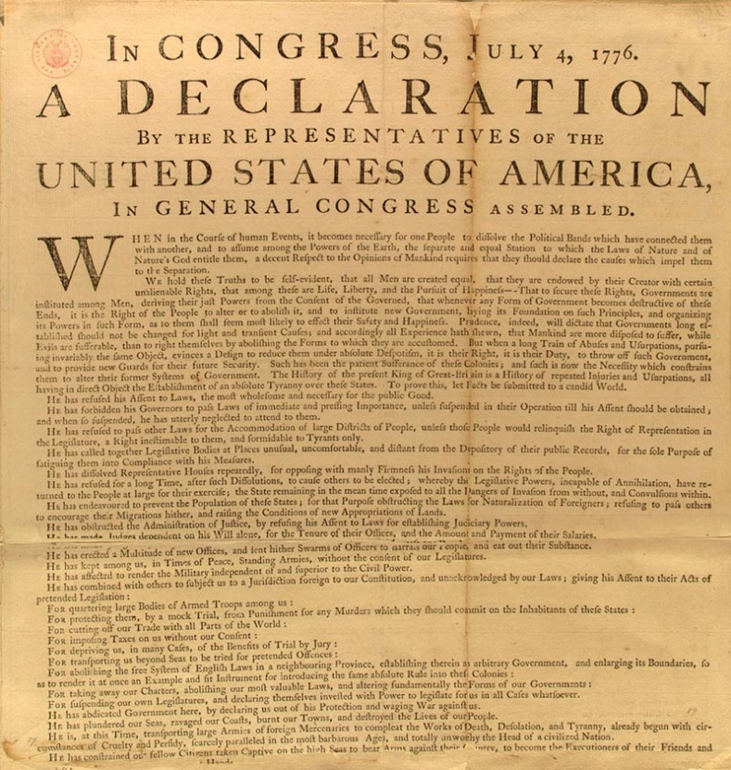
The Declaration of Independence
Written by Thomas Jefferson
We hold these truths to be self-evident, that all men are created equal, that they are endowed by their Creator with certain unalienable Rights, that among these are Life, Liberty and the pursuit of Happiness.--That to secure these rights, Governments are instituted among Men, deriving their just powers from the consent of the governed, --That whenever any Form of Government becomes destructive of these ends, it is the Right of the People to alter or to abolish it, and to institute new Government,
Notes:
LF- Have the learners identify where each highlighted/colored text originated from. Ex. All men are created equal –John Locke

Slide 9
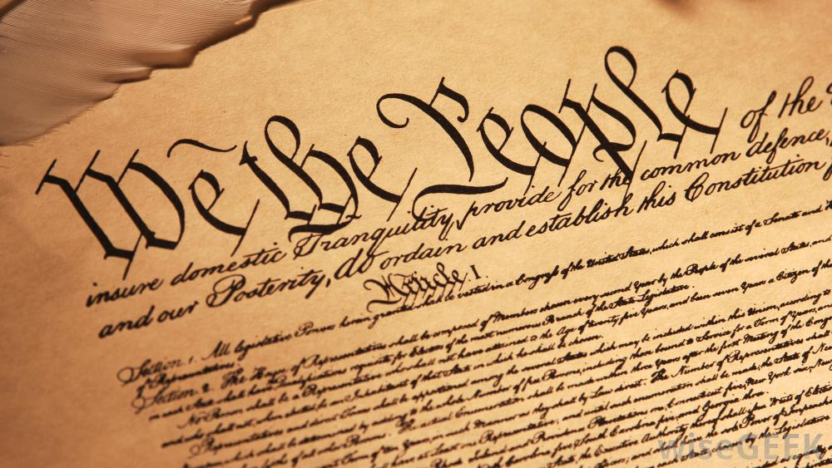
American Revolution (WAR)
England and the USA go to war
  War lasted 8 years
  USA wins freedom1783
  4 years later US Constitution is created
  Our current government
US Constitution
Created 3 separate branches of government to run USA government
US Bill of rights added to protect the rights of the people
Notes:
https://www.youtube.com/watch?v=Nnqk-yGzYYg

Slide 10
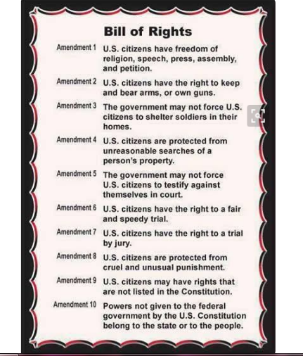
US Bill of rights
What document(s) influenced the rights you have today found in the US bill of rights?

Slide 11
Videos
http://study.com/academy/lesson/the-declaration-of-independence-text-signers-and-legacy.html
http://www.history.com/topics/american-revolution/declaration-of-independence/videos/declaration-of-independence

Slide 12
Assignment
Go back and highlight your notes for things you think are important
Create the flow map
Add your summary explaining how the documents and ideas effected the USA
Actions/Ideas Results
American Revolution
Use the following language: resulted in, caused, created, made, lead to, produced, shaped, and formed
Notes:
LF learners are to complete the second part (results) of the thinking map and add to their summary

