Slide 1
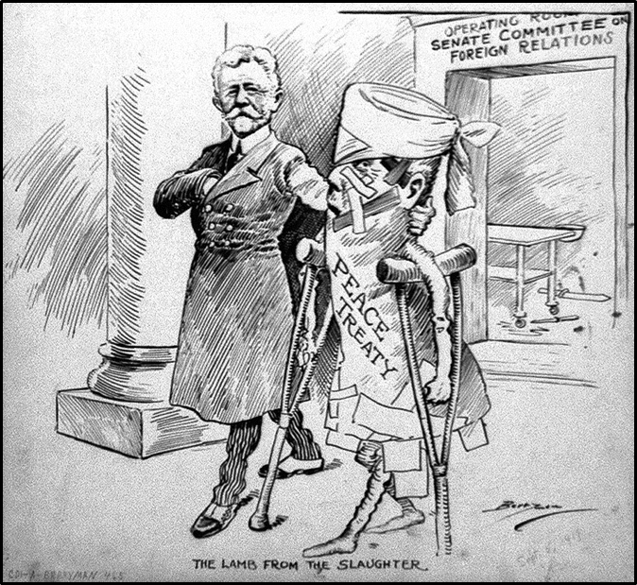
Mt3: The Causes and Effects of the First World War
LT4
Guiding Question: What were the effects of WW1?
How did WW1 effect nation’s borders, people, and nation’s economy?

Slide 2
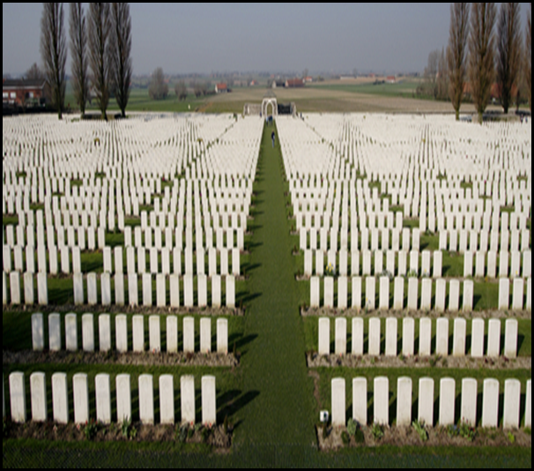
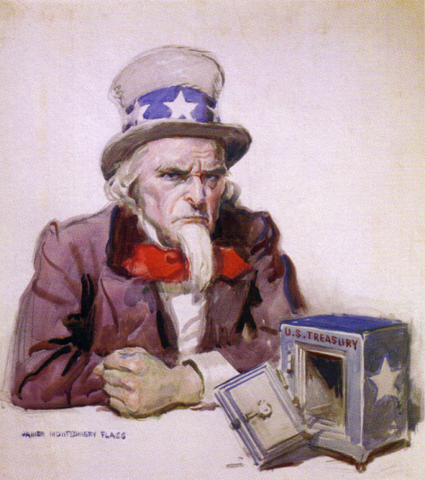
How did WW1 effect the whole world?
Entire generations of men are gone
So many died. young men between 17-35
Some villages/towns lost all their men
Every nation was financially effected
Almost all nations were broke, having money issues
Great Depression hit the world 10 years after WW1 – no one has money

Slide 3
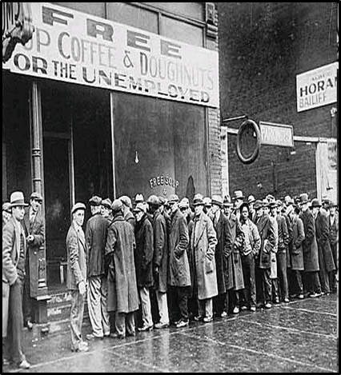
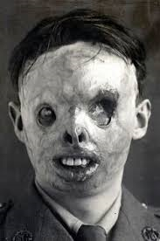
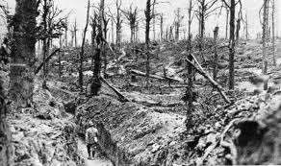
Effect on People
Poor- Their governments had no money, they no money,
No jobs-Many businesses/factories had been destroyed during the war
No food-Farm land had been destroyed during the war
Homeless- Many, many homes had been destroyed
New kind of health issues
Poison gas issues
War flashbacks- mental illness

Slide 4
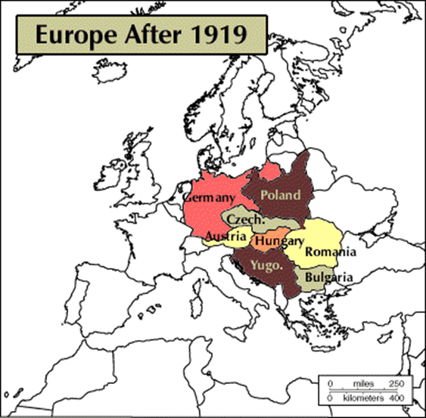
Border changes after WW1 and Treaty
New Nations created
Some nations gained land
France, Italy, Greece, Poland, Romania
Other nations lost land
Russia, Germany, Austria-Hungary, Romania
Some nations/empires disappear
Ottoman empire, Serbia, Montenegro
Austria-Hungary is divided up creating
Austria
Hungary
Czechoslovakia
Yugoslavia
New nations
Latvia
Estonia
Finland
Turkey
Iraq
Jordon
Syria

Slide 5
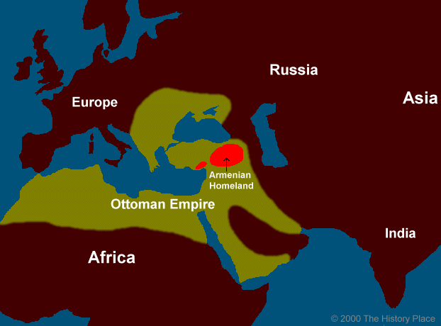
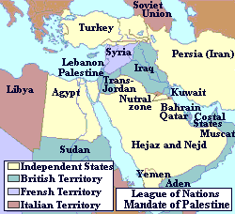
Mandate System
Question that needed an answer: What to do with Germany’s colonies and new nations?
League of nation creates a plan called Mandate System (Plan)
Plan = take care of newly created nations after WW1
England and France are put in charge of New Nations
Arabian nations
African nations/colonies
Notes:
New A

Slide 6
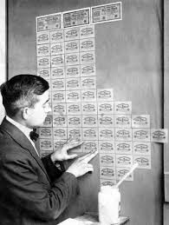
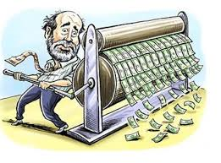
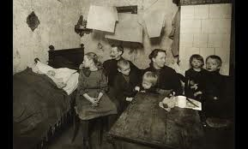
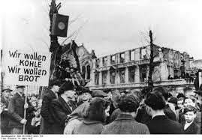
Germany hit the hardest
After WW1the Germany empire was wiped out – Lost land and King
New German government created called Weimer Republic
This new government has to deal with all the issues created after WW1
Economic depression – no $$$$
Poverty
Large payments to nations
High unemployment
Inflation- $$ had no value because gov just printed it
Germans upset/angry over how they were treated after war and all the issue didn’t help make things better

