Slide 1
MT:2 Industrial Expansion and Imperialism
LT4 Learning Target/Goal:
--Explain how the imperialized people were treated.
--Describe how the colonist (people who had been taken over/imperialized) responded.

Slide 2
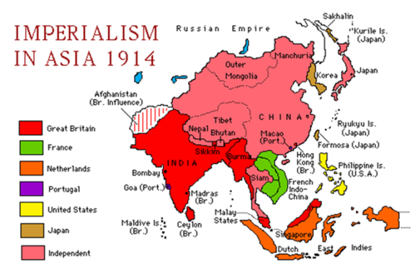
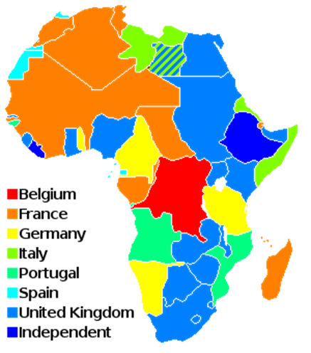
Imperialism
Which areas were imperialized? (Made into colonies)
Almost all of Africa
Many countries in Asia
All of India
All of South America
Reasons for Imperialism
Social Darwinism
Security (protection)
Missionary reasons (white man’s burden)
Nationalism/Prestige (To look good)
Natural Resources/Cheap labor

Slide 3
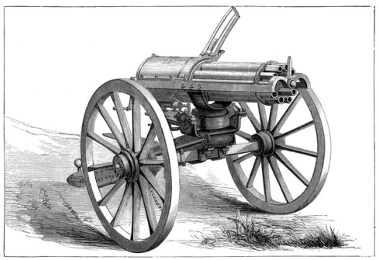
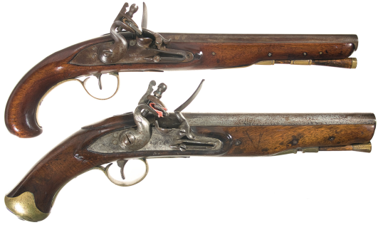
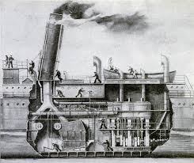
How was it so easy to imperialize?
European nations had technological more advanced weapons.
Europeans had new inventions such as the steam engine
Steam boat
Factories could create weapons, guns ammunition very quickly
Drug immunizations
Malaria shot to keep people from getting sick and dying

Slide 4
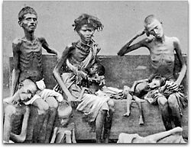
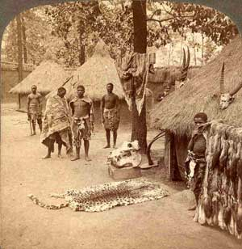
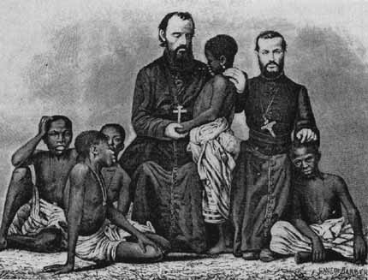
Treatment
Those who Imperialized Feelings-Attitudes
Treatment
Superiority – I am better than them
Social Darwinism
I am only here to exploit(take) their natural resources
I am here to help them be better cause they are savages
White Man’s Burden/Missionaries
Unfairly-abusive- “They are slaves”
Lost land-taken or destroyed to get natural recourses “I only want your good stuff”
Farmers planted cash$$ crops not food (Tabacco, cotton)
People starved
No respect for culture or customs –made people change “You have to dress like me”
Forced to work for low pay, long hours, bad working conditions

Slide 5
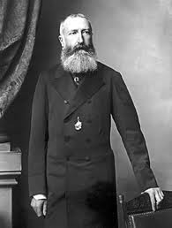
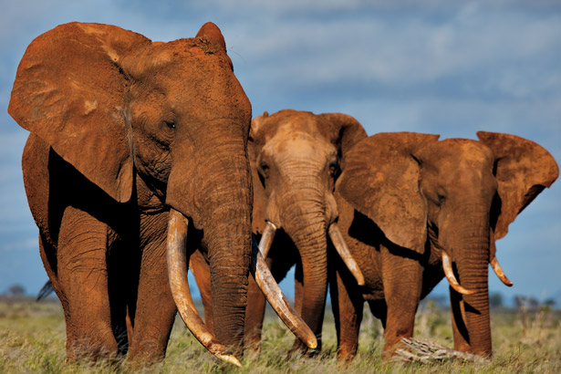
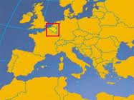
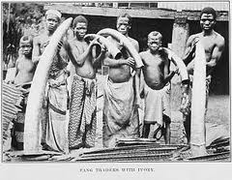
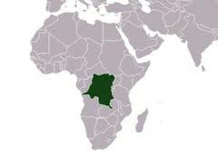
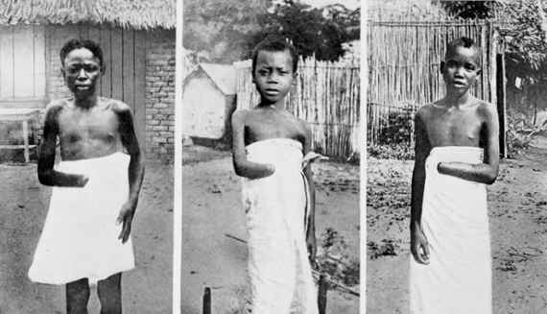
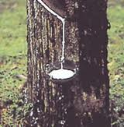
The Worst Was King Leopold II Of Belgium
Controlled the Congo
Only wanted natural resources
Ivory and rubber
He kidnapped wives and children and held them hostage for ivory or rubber
They were killed if no one returned
Burned villages who rebelled
Cut off peoples hands
http://www.youtube.com/watch?v=1JS6_BH8low&feature=player_detailpage
Notes:
Video is graphic

Slide 6
How Did The Colonized Feel And Respond? -The colonist resisted!
Angry
Africa
India
Asia
Sepoy Mutiny (rebellion)
Indian soldiers refused to use bullets
Protests for independence from England started
Mohandas Gandhi
Non violent protest
Fasts
http://www.biography.com/people/mahatma-gandhi-9305898/videos/mahatma-gandhi-a-legacy-of-peace-12169795858
Multiple rebellions everywhere
Opium War
Chinese rebel
England and China fight over trade control
Boer War
1899-1902
Against English control in S. Africa
Africans started Nationalism movements (proud to be non European)
Stressed
Hateful
Resentful

Slide 7
Long term Effects of Imperialism
Wealthy landowners in control of all the land and power/government
Colonized nations lost natural resources, and traditions forever
Nationalism develops through out the world
Nations believed they were the best!

Slide 8
Summary: Describe how the imperialized people were treated and how they felt and responded to the treatment.
Go back and highlight your learning goal
Go back and high light any of your notes that will help you understand your learning goal
Complete the thinking map and summary
Effects of Imperialism
How were the imperialized people treated?
How did Europeans who imperialized feel towards the colonies?
How did the imperialized people respond to colonization?

