Slide 1
MT2: Industrial expansion and Imperialism
Learning Target/goal #3
Which European nations industrialized after England?
Why did nations get involved in imperialism/colonialism?

Slide 2
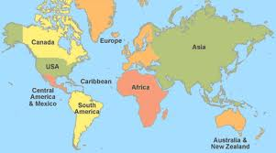
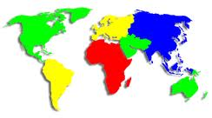
Map of the world

Slide 3
Create
Define
Sentence
Picture
Example
_____is ____.
When _____ it its ___
___ was ____
Imperialism/Colonialism

Slide 4
Vocabulary
Imperialism/colonialism: the political, military, or economic domination of one country over another for a long period of time
Colony: a country or area that is ruled by another country
Colonies: More than one colony
Industrial Economies- When nations earn money through manufacturing (making things in factories)/industrialization

Slide 5
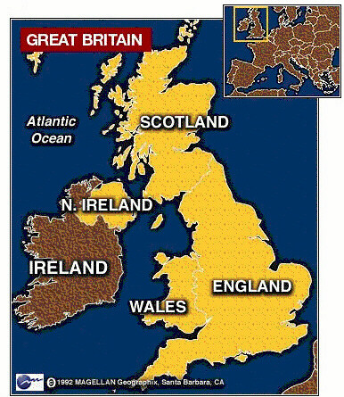
Industrial Economies created
England was the first country to industrialize
Industrialize means to take natural resources and change them with machines
They had the natural resources
Extra Food
They had the work force
Stable & supportive government
They had the capital
New inventions
They had the markets

Slide 6
Others follow (other countries industrialized)
Nations who industrialized/ Imperialize
France
Germany
Belgium
Italy
Spain
Portugal

Slide 7
Why did nations practice imperialism??
1. They needed new natural resources and laborers/workers
2. Nationalism: Pride in your country-Your country is the best!
3. Social Darwinism
4. National Security- protection for their own countries
5. Missionary reason/Christianization- To save the heathens (White Man’s burden)

Slide 8
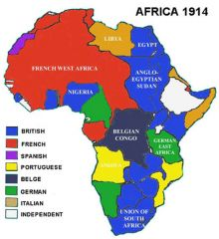
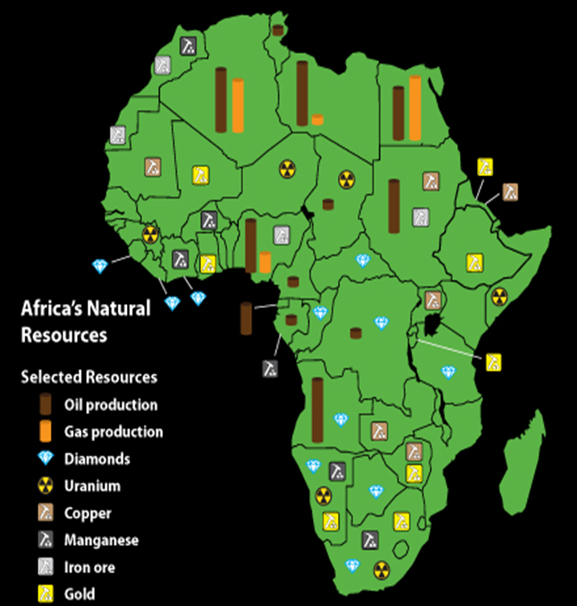
Why did nations start imperialism??
Imperialism: When stronger powerful nations take over other for their stuff!
WHY????????????????
1st The industrial countries needed natural resources
They were running out of natural resources
Markets to sell those products too.
Labor (cheap workers)/slaves

Slide 9
Check for Understanding
A-What is imperialism?
B- Why did nations practice imperialism?

Slide 10
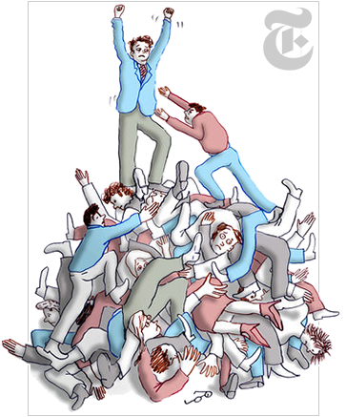
Why did nations colonialize/imperialize?
2nd-Nationalism
3rd-Social Darwinism
2nd-Nationalism: Pride in your country-Your country is the best!
Powerful countries wanted to gain advantages over their rivals/enemies.
Colonies were seen as prestigious (high class/status)
Only the most powerful countries had colonies so seen as weak if you didn’t have
3rd-Idea created by Charles Darwin that only the fittest (best) survives
“Survival of the fittest”
Weaker nations were destined/meant to be taken over
Ok to forcefully take over because they are weaker
Some races are better than others (white vs black)

Slide 11
Check for Understanding
A-What did nations who believed in nationalism think/feel?
B-What is the main idea of social Darwinism?

Slide 12
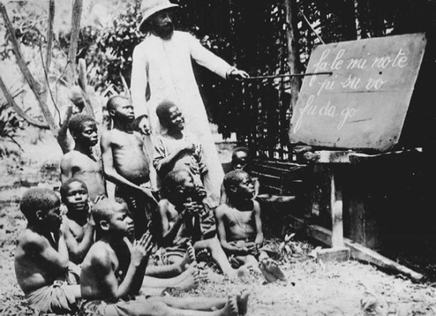
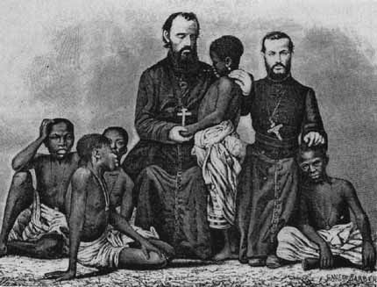
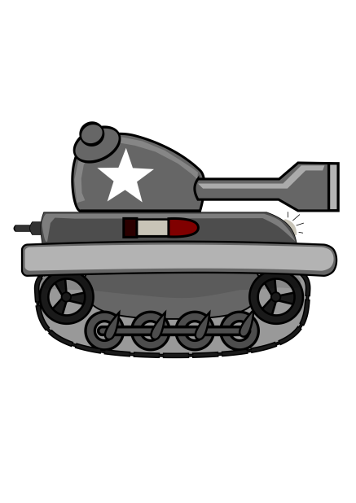
Why did nations colonialize/imperialize?
4th National Security
5th Missionary
Nations needed to protect their colonies
Nations began building up their Navy’s and armies to protect their colonies
Nations took over large areas of land and created colonies just for national security-protection!
Some people (called missionaries) really felt it was their duty to help those less civilized (Wild)
spread Christianity
Encouraged them to become Christians
Built churches

Slide 13
Check for Understanding
A--Why did nations who had colonies increase their national security?
B--Why did missionaries go to the new colonies?

Slide 14
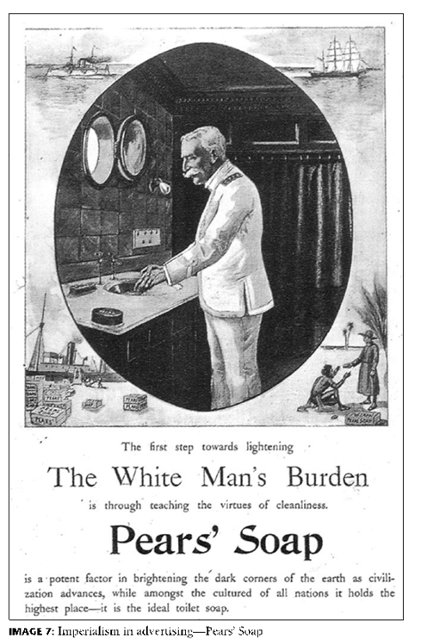
Why did nations colonialize/imperialize?
5th “White Man’s Burden”
Poem
Idea that Europeans had a “Christian” duty or responsibility to save, civilize, educate savages/heathens
Taught them English/other languages
Live in houses
Wear clothing
Take up the White Man's burden-- The savage wars of peace-- Fill full the mouth of Famine And bid the sickness cease; And when your goal is nearest The end for others sought, Watch sloth and heathen Folly Bring all your hopes to naught.
Notes:
https://www.youtube.com/watch?v=xRPwwvyHEUk

Slide 15
Check for Understanding
A—What was “white mans burden”?
B-Why was the idea “white mans burden” a reason to imperialize other places?

Slide 16
Berlin Conference 1884
Nations in Europe were fighting over natural resources and land in Africa
Meeting was held in Berlin, Germany
Africa was divided up between the European nations
No African countries/ leaders were at the Berlin Conference

Slide 18
Assignment
Go back and look at your learning goal
Highlight any information that you think will help you better understand your learning goal
Complete the one sided flow map for reasons nations imperialized Causes
Write a summary explain what imperialism is, which nations imperialized and for what reasons.
Imperialism
Notes:
__________is ______________. The following nations took part in imperialism; ___,____, ___ and _____. One reason _________took place was _______________ for______________. ____________also occurred/happened because ________________. __________________ led to ________________ because __________________. Nations also ___________ for the reason that _____________. Another reason imperialism took place was ___________since__________. Imperialism was _________.

