Slide 1
MT2: Industrial Expansion and Imperialism
World History
LT1: What made it possible for England to be the first nation to industrialize?

Slide 2
Vocabulary
Industrialization- The change from making things (products) by hand (growing food, making clothing) to using machines (new inventions) to make finish products.

Slide 3
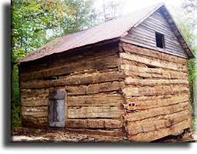
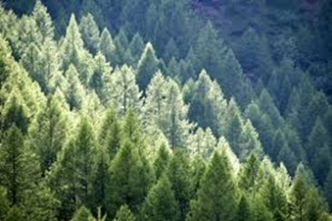
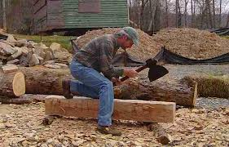
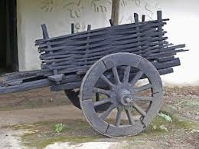
Prior (Before) industrialization
People did most of the work at home and then traded in their small towns
Notes:
Orange juice!!!

Slide 4
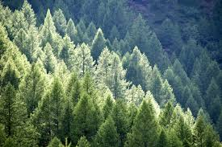
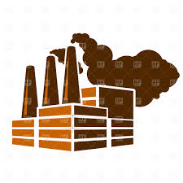
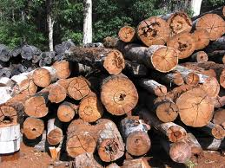
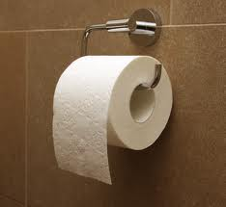
What is industrialization?
Industrialization- when you change raw materials/natural resources to a finished product in a factory

Slide 5
Why was England able to industrialize first?
More food was produced (grown)
Population increased
Lots of Money
Natural resources
Little government problems
Markets (places to sell the finished product to)

Slide 6
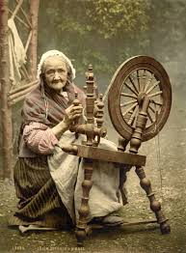
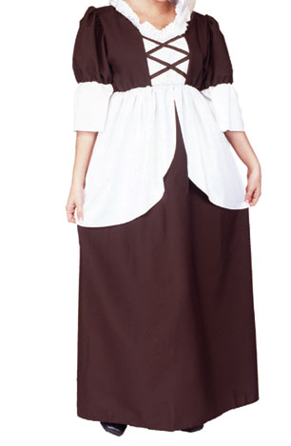
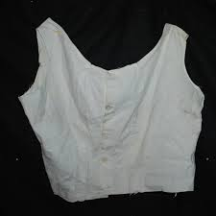
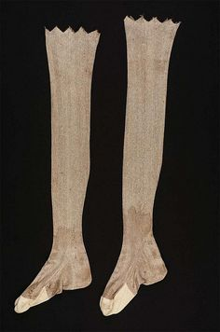
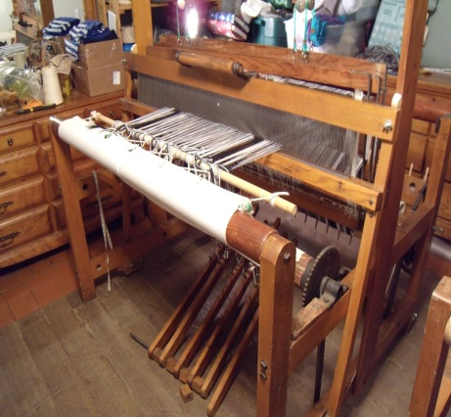
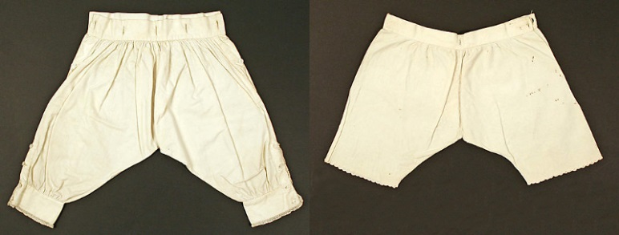
New inventions created
Back in the day how it was done
Video
http://www.history.com/topics/industrial-revolution/videos#the-industrial-revolition

Slide 7
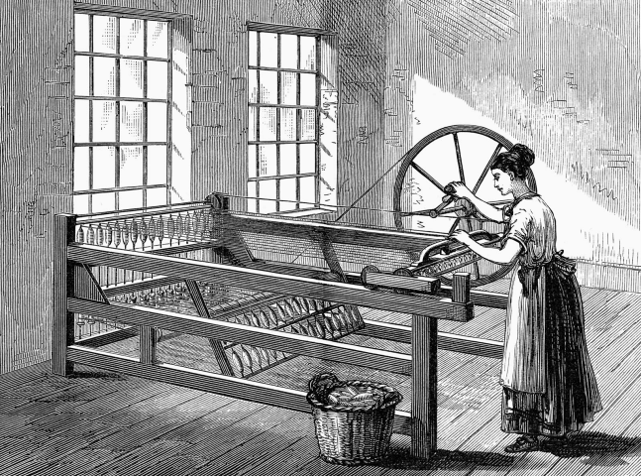
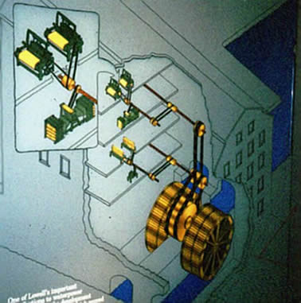
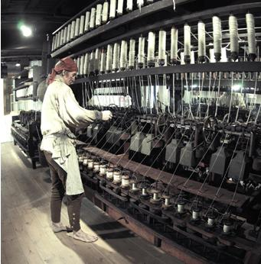
New inventions created
Spinning Jenny – Sped up the process of converting cotton to thread
Water Frame – Powered by water or steam
Steam engine
Factories could run 24 hours a day

Slide 8
1st-More food and 2nd people
Increase in food =
Population increases
How did food increase?
Better farming techniques (learned better techniques to grow food)
New crop the potato increased the food supply
Effect:
More food grown
Food is cheaper
The increase in cheap food meant people could afford to buy more food
More food meant people could support larger families
Effect: This created a large supply of labor (people who could work)

Slide 9
3rd-Money and 4th-natural resources
$$$$$$$$$ (capital)
Natural Resources
England (Britain) had $$ to invest in new machines and factories
Factory owners/ business owners would invest their money in creating new inventions/ machines
= better and better machines created to make better products
Natural resources (things not man made) were plentiful in England
Cotton to make clothing (textiles)
Iron to build factories and machines
Coal to burn for fuel to power the factories
Navigable rivers to transport supplies/goods and natural ports
Move stuff from factory to stores/cities

Slide 10
5th-Government and 6th-markets
stable Government
Markets (places to sell)
England’s government was stable (no drama like France)
England had very little laws regarding business
England (Britain) had colonies all over the world
England had lots of ships to transport the products
Population growth = more people to buy stuff and more people working = more money to buy stuff

Slide 11
Assignment
High light notes
Create a flow map outlining what helped England become the first industrial nation.
Write a summary explaining how England was able to become the first nation to industrialize.(5 sentences)
Use some of the following words in your paragraph:
Initially, first, followed by, meanwhile, as a result, caused, created, helped develop, resulted in, next, finally, ultimately, for that reason, led to,
Improved Ag. Techniques

