Slide 1
MT1: The development of Modern Political Thought
LT3: Understand the ideas of the French Revolution and other revolutions around the world.
Goal: I will know what events and ideas started the French Revolution

Slide 2
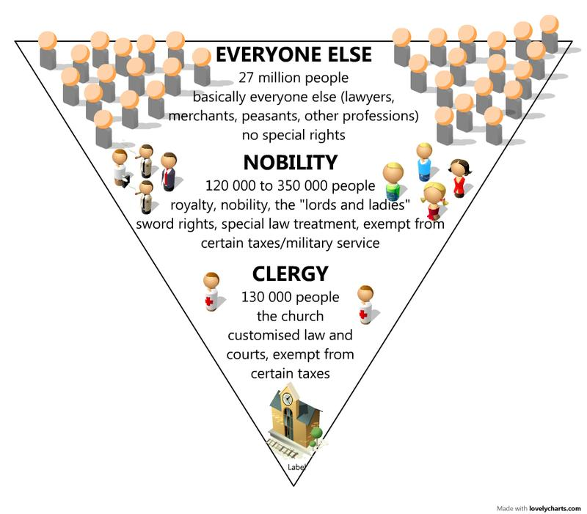
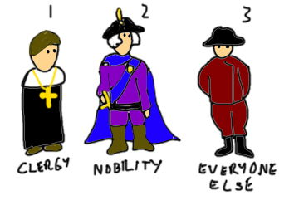
What's the problem?
French people divided up into unfair groups -three groups.
Groups are called Estates
1st Estate- Clergy (church people)
2nd Estate- Nobility (royal people)
3rd Estate- Everyone else –Only group to pay taxes

Slide 3
What’s the problem?
King Louis XVI of France had put France into debt
90% of the French people were starving, or homeless
The king wanted to raise taxes again to pay off the debt
The 3rd estate was not happy so they rebelled
Why u mad bro?
Taxes
No equal vote
King locked them out of vote
Actions
Made an oath (promise) to write a constitution
Tennis Court Oath
Create the Declaration of the Rights of Man and the citizens
Got the idea from USA declaration of Independence
The people rebelled
Took over the city
Arrested the King
Beheaded the king

Slide 4
Why A Revolution???????
Ideas
Actions
The French people saw the success of the American Revolution
The French people knew the ideas of:
John Locke- Natural Rights
The governments job is to protect the rights of the people
The governments power comes from the people
Overthrow a corrupt government
Montesquieu –Separation of power
90% of the people were starving, poor, homeless, sick and no one cared
King wanted to raise the taxes
Totally unfair the people thought
The king didn’t let them (3rd estate) vote
Denied them their basic rights

Slide 5
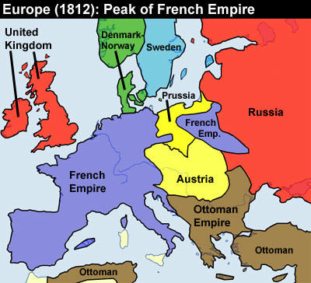
Major Events of the French Revolution
Tennis court Oath- Start of the revolution
Declaration of the Rights of Man and the citizens written for the people-Gave power to the 3rd Estate!
Storming of the Bastille- French people attacked the prison and armed themselves for the revolution
Took the king and beheaded him and his wife
After the French Revolution, the reign of Louis XVI went from an absolute monarchy to a constitutional monarchy.
Reign of Terror – Beheading of 75% of the nobility in France
Started killing of members of the 2nd Estate
Napoleon takes over France as Emperor
Last 15 years
He ruled almost all of Europe before being sent away to a small island

Slide 6
More Effects of the French Revolution
Radicals were more in touch with the French Revolution's ideals of "liberty, equality, and fraternity
The idea of a democracy where all males could vote.
Not all of the problems (grievances) were handled at this point. This was due to the idea of nationalism getting in the way. The pride of your own country or group as the best.

Slide 7
Thinking Map
Go back and highlight your notes for things you think are important
Create the flow map
Write a summary explain what ideas/actions led to the French Revolution.
Causes Effects
French Revolution
Use the following language to help you write your summary: influenced, motivated, inspired, shaped, guided, led to, caused, resulted in, developed, changed, transformed

