Slide 1
Measurement Topic 4: The causes and effects of World War II
Learning Target/goal #4 Essential Question
-Explain the Nazi policy/plan of racial purity, and the final solution during the time known as the Holocaust.

Slide 2
Terms
Ghettos-Parts of cities blocked off were Jews and other groups were forced to live
Similar to house arrest but whole city
Concentration camps- Large camps were the Nazi’s sent people to work
Similar to jail-at 1st just for prisoners, then unwanted races
Genocide-The mass killing of a group of people based on race, religion or nationality
Holocaust – The time period when the Nazi Germans killed/exterminated millions of Jews, gypsies, Slavic's, Christians, Poles, and other groups

Slide 3
Basic Information
As WW2 is going on in various places in Europe, Germany was slowly destroying races of people not German-
This time in history is known as the holocaust
Jews
Polish
Slavic groups;
Catholics
Homosexual
Gypsy

Slide 4
Quote from Hitler
“Whether nations live in prosperity or starve to death interests me only insofar as we need them as slaves for our cultures. Otherwise it is of no interest.”
Hitler's steps known as Holocaust
Makes Jews hated
Created laws to limit the freedoms of Jews
Racial purification-purify the German race
Tells Jews to leave
Forces Jews to leave
Jews placed in Ghettos and Concentration camps
Final Solution
Death Squads
Death Camps

Slide 5
Hitler targets Jews
When Hitler took over power he targeted the Jews as the reason for Germany’s failure (1933-1939)
He passed laws called the Nuremberg laws
Jews were not allowed to walk on sidewalks
Jews had to wear a yellow star on their sleeves identifying them as Jews
Jews could not date/marry people other than Jews
Jews not allowed to be part of the government
Jews not allowed in the army
Forced to called “Sara” for women and “Israel” for men
Had to give-up all their property to Germans
Nazi’s terrorized the Jews by destroying Jews business, churches and homes – Knight of Terror
Notes:
Watch piece of Pianist old man pushed off sidewalk

Slide 6
Racial Purification:
Hitler/Nazi beliefs
Goal of Racial purification: *make Germany free of all groups of people except Germans
Afraid Jews were trying to destroy Germans and control the world
Felt/believed Germans superior race (Master race- Aryans, blue eyed, blond hair)
Wanted to get rid of anyone not part of his Master race so he started a purification process
Steps to Racial purification
Step #1: All unwanted groups (Jews, Slavics, Christians had to leave Germany)
At first voluntary
Later by force
Step #2: Placed unwanted races into Ghettos and concentration camps (segregation)

Slide 7
Racial Purification
Ghettos
Concentration Camps
Nazi would block off sections of cities all over Europe and force the Jews/other unwanted races to move there to live
Ghettos were small
Extremely overcrowded
Offered little or no:
Food
Protection
Medical treatment
Life was extremely difficult!!!!!
Some Jews/unwanted races were placed in concentration camps
The goal was to get the most work out of a group of people before they died
Worked all day long
Feed little to nothing
No medical treatment for those injured
Notes:
Show part of pianist with ghettos being blocked off
Show shinderlist with concentration camps

Slide 8
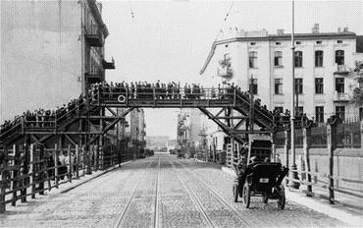
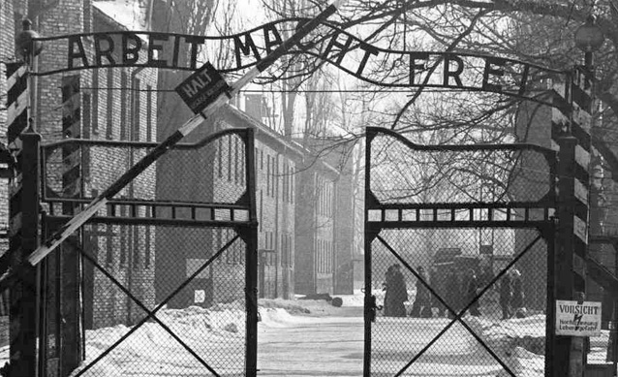
Ghettos

Slide 9
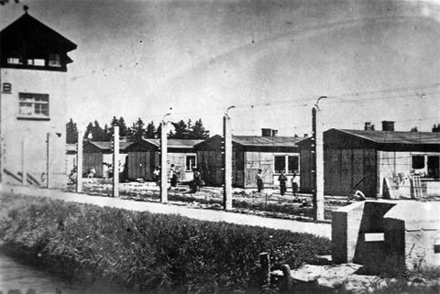
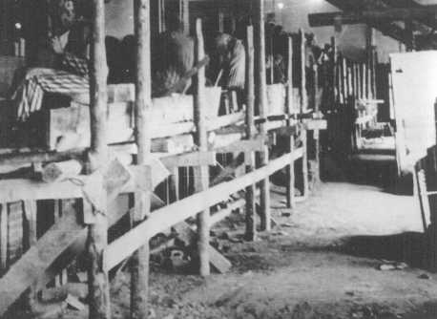
Camps

Slide 10
Final Solution
Hitler was not happy with the slow progress of the racial purification process so he changed his plan.
Nazi’s (Hitler) came up with a plan for exterminating (killing) Jews and other groups –Final solution
Special task force created to round up all Jews and other races
Cities, Ghettos and concentration camps were cleared out
People taken to Death Camps

Slide 11
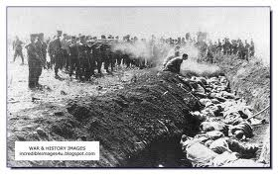
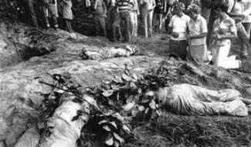
Death Camps
Death camps: place to kill unwanted people in mass numbers
Some were worked to death
Some were killed by mass shootings
others used in weird experiments
others were put in gas chambers
Women and children were the first to be gassed
Largest Death camp was Auschwitz

Slide 12
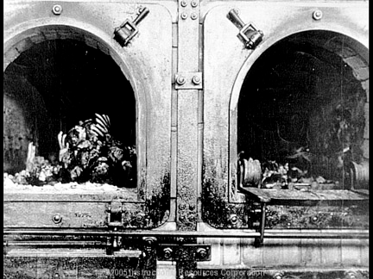
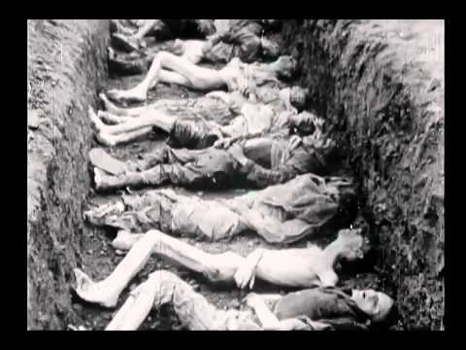

Slide 13
Effect of Holocaust
Entire ethnic groups had been forced to leave homes
Many never returned home
Some had no homes to return to
90% of Jews in Europe were killed
1.2 million were children
40% of Roma (Gypsies population) were killed
3-4 million Russians killed
Countless groups of people where left disabled; mentally and physically
Many people left family less (no other family)

Slide 14
Complete the tree map
Holocaust
 | Racial Purification |  | Final Solution
What was it?
What steps were taken to carry out the plan?
Who was involved?
Result:

