Slide 1
Mt4: The causes and effects of WW2
Essential Questions/Learning Goal:
Lt2: Explain what Germany, Italy and Japan did to expand their empires in the 1930s.
Lt3: Understand the role of appeasement by the European leaders towards Hitler.
And the role of nonintervention by the USA prior to WW2.

Slide 2
Expansion
Expansion: To increase in size. Nations usually expanded by forcefully taking over other nations land/area. Usually with battles/wars.
Why nations practiced expansion?
Nations looked for natural resources, cheap labor, and to appear more powerful/ prestige's.

Slide 3
Italy/Mussolini
Mussolini wanted make Italy a world power – “Make Italy as powerful as the Roman empire”
Mussolini said the only way to make italy a world power was to expand it’s empire
Take over other places

Slide 4
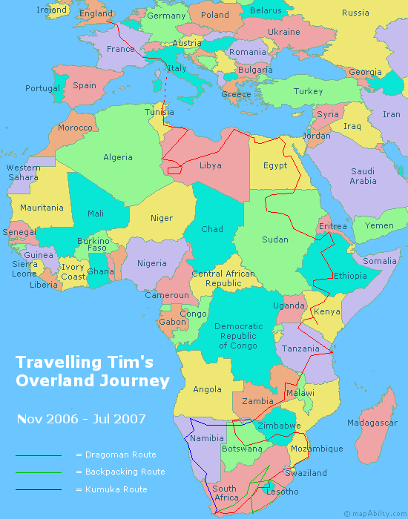
Mussolini – Italy – Fascist
Steps to domination
Mussolini invaded Ethiopia found in Africa to expand his empire in 1935
Took 7 months to claim Ethiopia
He then went on to invaded Albania in 1939
League of nations does nothing – Non intervention
Mussolini was not punished for invading other nations
Mussolini then united himself with Hitler.

Slide 5
Germany/Hitler
Hitler wanted to bring Germany back to its former glory
He felt that Germany had to show that Germans (Aryans according to him) were the most powerful people

Slide 6
Hitler –Germany-Nazi Socialism
Steps to domination
1st – created an air force
2nd created a military draft (make people join) which expanded their army 5X
(France, and Great Britain warned Germany not to continue aggressive steps) 3rd – In 1935 Germany entered the demilitarized area (Rhineland) between Germany and France with the German army
(France could have attacked them for this, but they didn’t because Great Britain was “ok” with Germany being there)
Great Britain/England was practicing appeasement with Germany –
Appeasement is to not get involved, turn the other cheek, ignore the situation, letting others have their way
Great Britain/England did not want another war

Slide 7
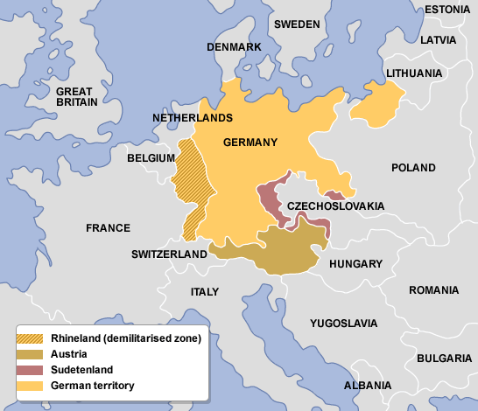

Slide 8
Domination cont.
By 1937 Germany was once again a “world power”
He felt no threat from France or Great Britain
On March1938 he invaded Austria, his homeland
On September 15, 1938 Hitler demanded Czechoslovakia give him “Sudetenland” in north Czechoslovakia
The Munich conference was called to stop Hitler
Great Britain, France, Germany and Italy
They (above listed) agreed to let Germany take over Sudetenland if Germany promised to stop taking over nations
Great Britain was practicing appeasement with Germany,

Slide 9
Hitler takes action
After the Munich conference, Hitler was convinced the western democracies (England, France and USA) were weak and wouldn’t/couldn’t stop him
1939 Hitler invaded and gained control of all of Czechoslovakia
He also demanded Poland
Great Britain and France tried to get the Soviet Union to join them but on August 23, 1939 Germany and the Soviet Union signed the “Nazi-Soviet Non-aggression Pact”
Nether would attack

Slide 10
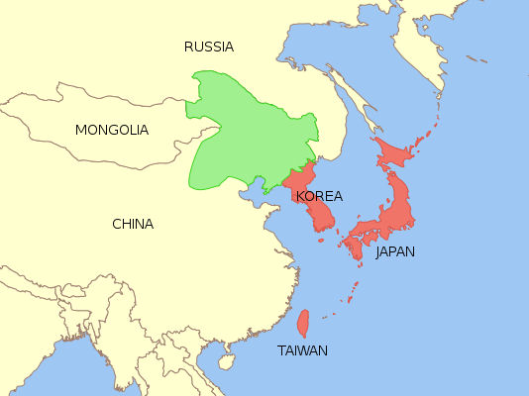
Japan Expands
Red area
Controlled by
Japan
Green area
Manchuria
Was taken over
By Japan
Nanking

Slide 11
Japan Expands it’s Empire
September 1931 japan takes over over Manchuria , in China, for natural resources
Japan claimed China attacked them, but Japan lied
League of nations investigates and Japan leaves League of nations
China’s leader, Chiang Kai-shek, tried to ignore (appease) Japan to deal with his own issues in China
United States sees what Japan doing and doesn’t approve
USA stops selling Japan important resources like steel and fuel to try and stop them, which angers Japan
Japan wanted parts of Russia, but when Hitler made the pact with the Soviet Union, Japan needed a new plan
Japan invades Indonesia, controlled by France

Slide 12
Rape of Nanking
In December of 1937, the Japanese Imperial Army marched into China's capital city of Nanking and proceeded to murder 300,000 out of 600,000 civilians and soldiers in the city.
The six weeks of carnage/murder became known as the Rape of Nanking
The Japanese soldiers committed unthinkable acts of cruelty in Nanking.
Everything you can imagine done, was done
Killing, torture, rape, abuse, anything

Slide 13
USA Nonintervention
Nonintervention-not getting involved, staying way from problem
People in the United States did not want to be part of another war
The USA was dealing with great depression
The USA stayed out of the issues and followed a foreign policy (plan of action) of isolationism (remain alone) after WW1
The USA wanted to avoid any tie/connection to nations
The USA knew Japan, Germany and Italy were up to no good but they choose nonintervention / isolationism as their plan of action
The USA creates laws called neutrality acts/laws to keep the USA neutral
The USA did not want to fight Japan either
USA only reacts to Japan with embargos (refuse to sell them stuff/buy stuff)
Japan sees USA as weak

Slide 14
World War 2 starts
Europe
Japan (Asia)
Hitler did not keep his promise to stop invading nations
On September 1, 1939 Hitler invaded Poland
He did not fear Russia
On September 3, 1939 Great Britain and France declared war on Germany
Germany bombs England
By June 1940 Germany controlled ¾ of France
June 22 1941 Germany betrays the Soviet Union/Russia and invades them
Japan felt it needed to take the USA out of the picture
Japan felt the USA was weak
December 7, 1941 Japanese aircraft attack the U.S. naval base at Pearl Harbor, Hawaii
On the same day Japan attacks the Philippines and Malaya and other islands in the Pacific Ocean
December 8th the USA declares war on Japan and it’s ally Germany

