Slide 1
MT2: Industrialism and Imperialism
LT#2: Describe the development (creation) and basics of capitalism and communism

Slide 2
Big Change
Prior to Industrialization:
  People lived in and near
castles (peasants worked for
master of the castle in exchange for shelter and
protection)
    Trade of goods for a service
Industrialization changed the
way products and money was earned/used

Slide 3
CAPITALISM is formed because of Industrialization
What is it?
3 basics
Capitalism is an economic system (economic system is a way to earn money)
  Money is used to reward work
  Money is used to purchase products
1. Private Ownership
  Businesses
  land
2. Goal is to make money! $$$$
3. supply and demand
  Money is made by selling things based on supply and demand

Slide 4
CAPITALISM
1. Private Ownership
2. Profit motive
3. supply and demand

Slide 5

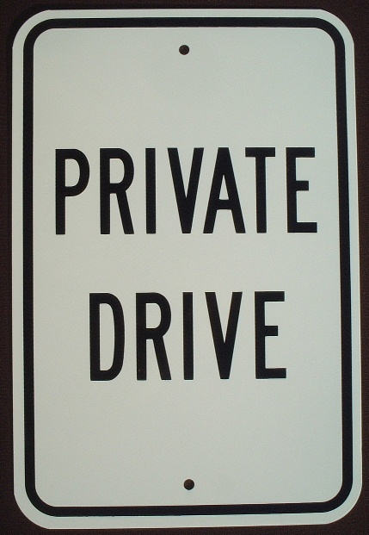

CAPITALISM
1. Private Ownership:
  Capital, $$$, belongs to individuals who are FREE to do what they wish with it.
  Land and businesses are privately owned (people owned)
  Minimal(very little) government involvement- Key person Adam Smith said “laiseez-faire”

Slide 6

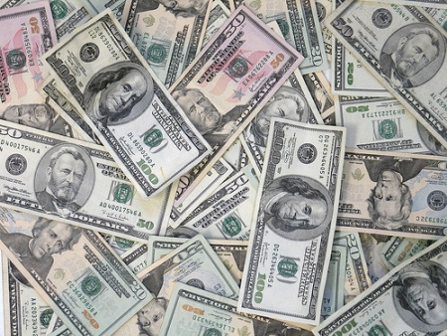
CAPITALISM
2. Profit Motive: Products are made because business owners wants a PROFIT$$$$

Slide 7
CAPITALISM
3. Supply and demand
  Products (supply) are made based on what people want (demand)
Example:
  Iphone 7 cost $600 because people want it (demand) so apple supplies it at a high price(supply)
Notes:
Don’t wrote notes on this slide

Slide 8
Capitalism
Pro’s (+) of capitalism
Con’s (-) of capitalism
People can or are free to buy any products they want due to competition between businesses
Anyone can make money
Products are cheaper because there is a big selections of products
Uneven distribution of WEALTH
  Poor people live in SQUALOR: slums, bad sanitation, etc.
Working conditions are miserable
No one cares about the old, sick and injured because they cant work

Slide 9
Thinking Map
Go back and highlight your notes for things you think are important
Create the bubble map
Write a summary about capitalism. Minimum of 5 sentences!
Capitalism

Slide 10
After taking notes on page 1-8
Complete handout Mt2 LT2 Handout #2 on capitalism before taking more notes

Slide 11
Responses to “Capitalism”
Capitalism was not popular with everyone
  Some people felt that a new economic system was needed to protect the working people

Slide 12

Utopianism
What is utopianism?
Utopias created in response to capitalism
An idea that society can be made much better or even perfect by human effort
What is a Utopia?
  Perfect society based on cooperation instead of competition
  Everyone works together to support the society
  Everyone has all there needs met (shelter, food, and security)
People tried living in Utopia’s but they all failed

Slide 13
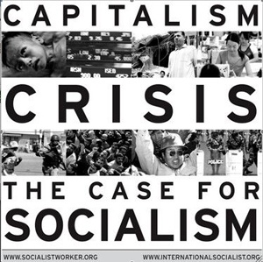
Socialism:
The government own the key pieces to make a society/government successful for the people
  Ex. Electricity, transportation, water, gas, food production
Principles:
  “Equality of all People”
    Everyone gets =money
    Everyone gets = medical help
  Cooperation is better than competition

Slide 14
BASIC DIFFERENCES BETWEEN SOCIALISM AND CAPITALISM
Capitalism
Socialism
Capitalism: Businesses are owned by individuals and corporations
Capitalism: Fosters a competitive atmosphere in which workers and companies are encouraged to work hard to achieve personal success
Capitalism: Ownership of private property is encouraged
Capitalism: Produces goods based on the law of supply and demand
Socialism: Businesses are owned by the government for the people
Socialism: Encourages an atmosphere of cooperation in which no matter how hard a person works, he or she reaps the same benefits as everyone else.
Socialism: Ownership of private property is largely forbidden
Socialism: Government commands production and prices.

Slide 15
COMMUNISM
What is it?
Main ideas/beliefs
In theory, A government were the people own and share everything
Reality, one person is in charge of the government and everything
A revolution must take places to overthrow the government
One powerful leader is in charge
The government controls EVERYTHING for the good of the people
Everyone will become equal

Slide 16
Basics of Communism
Government owned banking system
Government controlled education
Government controlled jobs
Government ownership of transportation and communication
Government ownership of agricultural and factories

Slide 17
Communism
Pro’s (+) of communism
Con’s (-) of communism
Everyone is equal
  Same wage, same house, same clothing
Everyone gets free medical treatment
Everyone can go to school
Everyone has a job
Not a lot of choice
  Live where the government tells you
  Eat what the government provides
  Job is what the government gives you
  Gov. teaches you what wants to teach you
Those that complain about the gov. are seen as rebels= jailed

Slide 18
BASIC DIFFERENCES BETWEEN Communism AND CAPITALISM
Capitalism
Communism
Capitalism: Resources are owned by a private owner.
Capitalism: Competitive atmosphere in which workers and companies are encouraged to work hard to achieve personal success
Capitalism: Produces goods based on the law of supply and demand
Communism: Government owns resources
communism: Encourages equality
Communism: Government decides what products to produce/make and distribute/give away

Slide 19
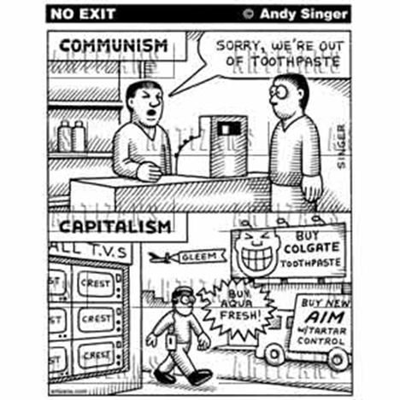
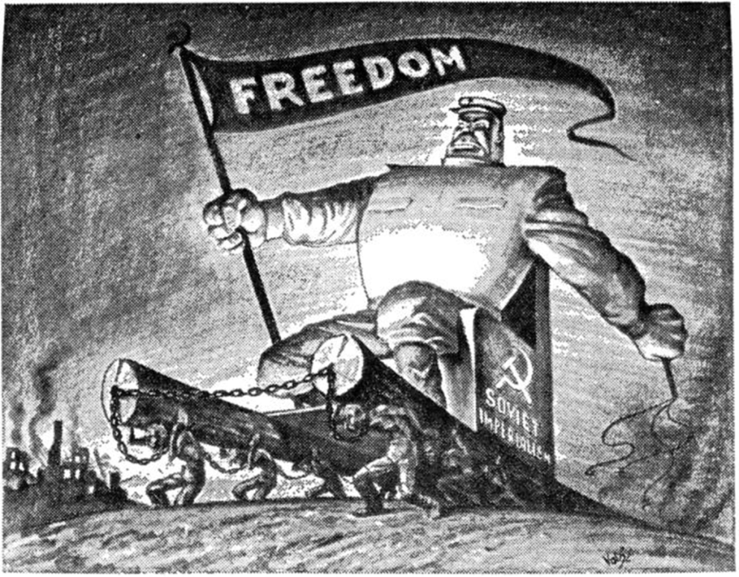

Slide 20
Assignment
Go back and look at your learning goal
  Highlight any information that you think will help you better understand your learning goal
Complete the following tree map
Write a summary stating the basics, positives and negatives of each government/economic system
Different forms of government/economic systems
 | Capitalism | Utopianism | Communism
Basic beliefs
Pros
cons
Notes:
___________is__________. One basic belief of __________ is _________. A positive thing about ___________ is ___________, while a negative detail about _______________ is _____________.

